Slide 1
CS 33 – Discussion 1A Computer System Organization
Week 8

Slide 2
Questions before we start?

Slide 3
Logistics
Lab 4 – parallel lab – OpenMP multithreading\
Due 11:59pm Friday June 5th
HW 4 and HW5 have been released
Hw 4 due: Wednesday, 27 May 2020 11:59pm PDT
Hw 5 due: Wednesday, 3 June 2020, 11:59 PM PDT
Please submit suggestions on CCLE TA-site on how to improve OH/Disc.
Please fill out LA survey on CCLE if you haven’t already

Slide 4
Agenda
10am-11am PST:
Exceptions
Linking
Virtual Memory
11am-11:50am PST:
LA worksheet

Slide 5
Exceptions
Exception:
An event, which occurs during the execution of a program, that disrupts the normal flow of the program's instructions. During an exception, control is transferred to the OS.
An exception table stores pointers to exception-handler code, where the exception number is used as an index into this table.
3 things can happen after exception-handling code is executed:
The current instruction gets executed again – recoverable, restart
The next instruction gets executed – recoverable, onto the next
The program aborts – unrecoverable

Slide 6
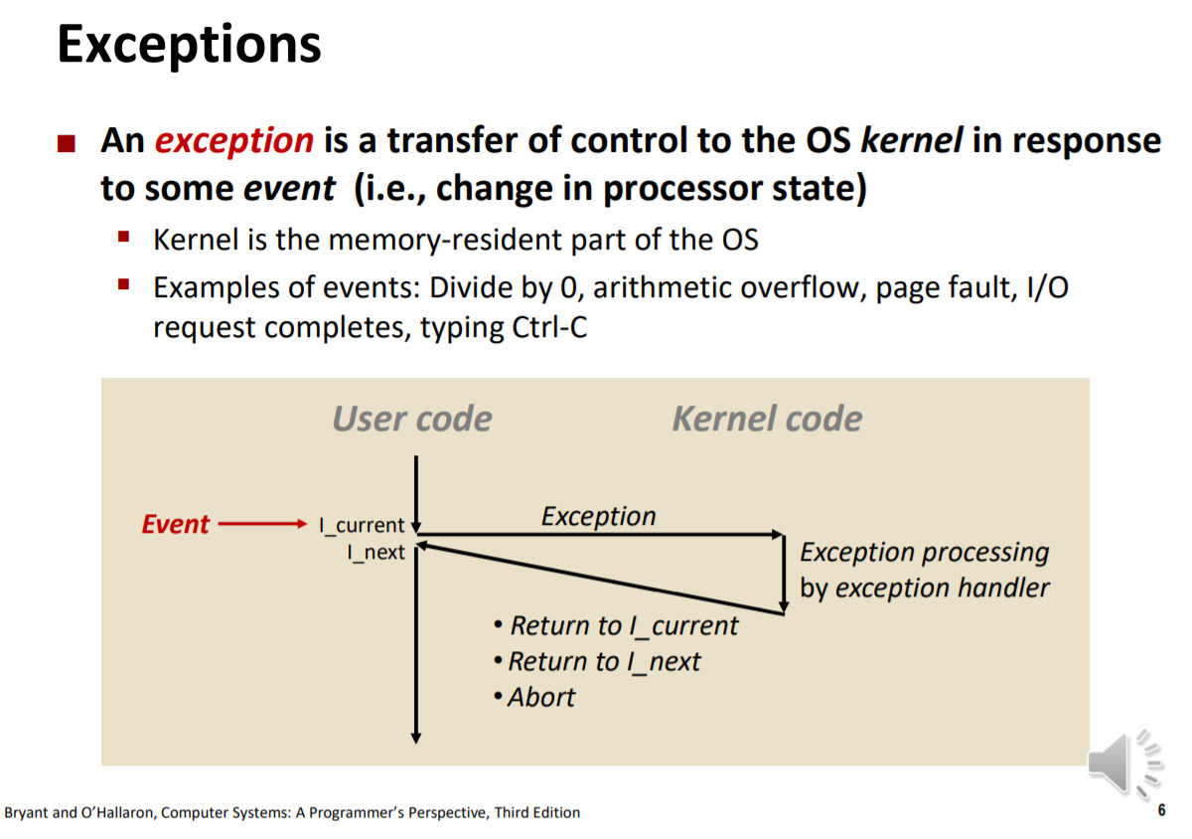
Exceptions

Slide 7
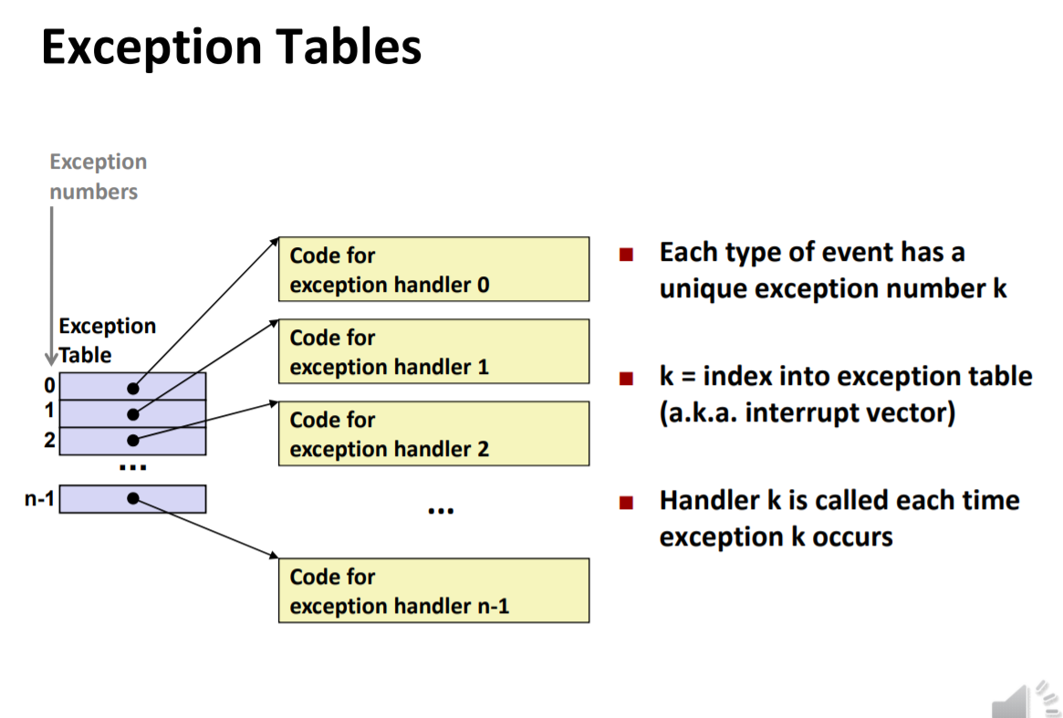
Exceptions

Slide 8
Exceptions
Types of exceptions :
1) Asynchronous:
Caused by events or devices external to the processor and memory, e.g. network delivers packet, disk delivers page, keyboard interrupt.
Control returns to the next instruction
2) Synchronous:
Caused by the execution of an instruction
Traps - Intentional, control returns to next instruction e.g. syscall to fork thread
Faults - Unintentional, possibly recoverable, re-executes current instruction or aborts e.g. pagefault (recoverable), division by zer0
Aborts - Unintentional, unrecoverable, e.g. access bad memory (seg fault)

Slide 9
Exceptions
Types of exceptions :
1) Asynchronous:
Caused by events or devices external to the processor and memory, e.g. network delivers packet, disk delivers page, keyboard interrupt.
Control returns to the next instruction
2) Synchronous:
Caused by the execution of an instruction
Traps - Intentional, control returns to next instruction e.g. syscall to fork thread
Faults - Unintentional, possibly recoverable, re-executes current instruction or aborts e.g. pagefault (recoverable), division by zer0
Aborts - Unintentional, unrecoverable, e.g. access bad memory (seg fault)

Slide 10
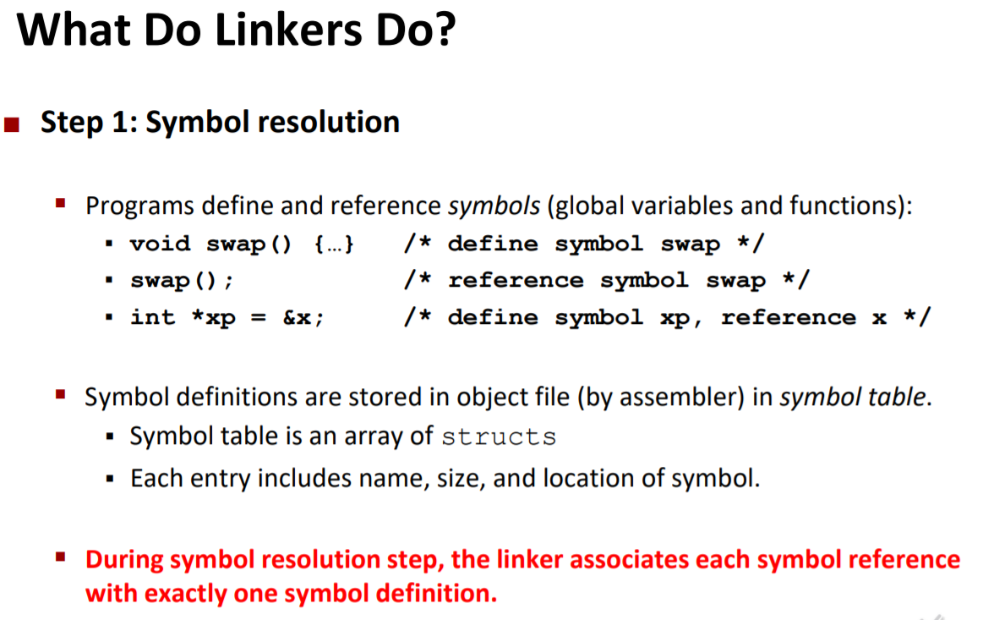
Linking
Steps : Symbol Resolution:
Associating variable and function references to variable and function definitions.
Exactly one definition paired to all declarations – no multiple definitions allowed
Stores information in symbol table of relocatable object file
This has implications in terms of the order files try to be compiled in on the command line.

Slide 11
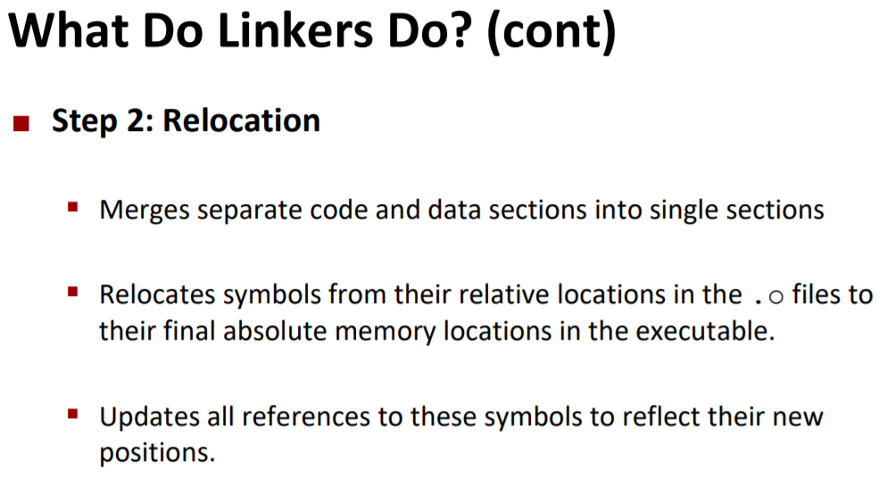
Linking
Steps : ObjectCode Relocation;
Combining data and code sections of different object files
Relocating variables and function from locations in their own object files to final memory locations of the executable
Updating references to these variables and functions with the new memory locations

Slide 12
Linking
Relevant file types :
Relocatable object files (.o) - Combinable with other .o files to produce executable, contains symbtab with definitions in this file and unresolved refs
Executable object file (a.out) - Ready to be copied to memory and executed – next step call loader
Shared object file (.so) - Object file that can be linked dynamically at load-time or run-time
Archive files/Static libraries (.a) - Collection of related .o files. When linked with, .o files - resolve references are pulled into the final executable

Slide 13
Linking
Relevant file types :
Relocatable object files (.o) - Combinable with other .o files to produce executable, contains symbtab with definitions in this file and unresolved refs
Executable object file (a.out) - Ready to be copied to memory and executed – next step call loader
Shared object file (.so) - Object file that can be linked dynamically at load-time or run-time
Archive files/Static libraries (.a) - Collection of related .o files. When linked with, .o files - resolve references are pulled into the final executable

Slide 14
Linking
Relevant file types :
Relocatable object files (.o) - Combinable with other .o files to produce executable, contains symbtab with definitions in this file and unresolved refs
Executable object file (a.out) - Ready to be copied to memory and executed – next step call loader
Shared object file (.so) - Object file that can be linked dynamically at load-time or run-time – used for dynamic linking (DLLs in windows)
Archive files/Static libraries (.a) - Collection of related .o files. When linked with, .o files - resolve references are pulled into the final executable – used with static linking

Slide 15
Linking
Types of symbols :
Global symbols - Symbols that can be referenced by other files, except static symbols in C
External symbols - Global symbols defined by other files, declared in this file
Local symbols - Symbols that are defined within the file and can only be referenced within the file, like static symbols in C or local variables to a function
Local vars are stored where? (hint: function call)

Slide 16
Linking
Types of linking
1) Static linking:
Copy all modules used by the program into final executable
Uses .a or .o files
Executables are not compact/space-efficient
Entire program needs to be re-compiled and re-linked if a single file changes
Usually facilitates faster programs
Programs have constant load-time into memory
Very portable – only need to ship exe

Slide 17
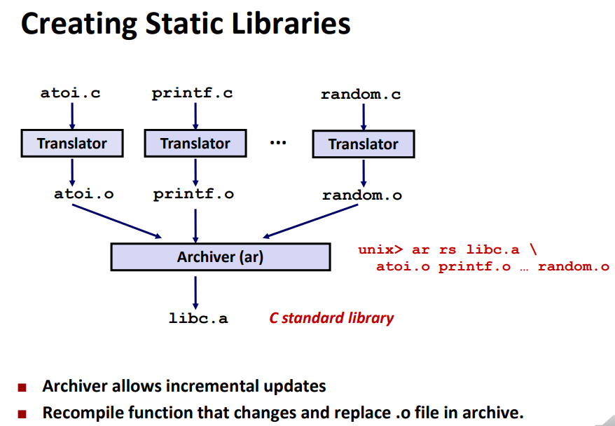
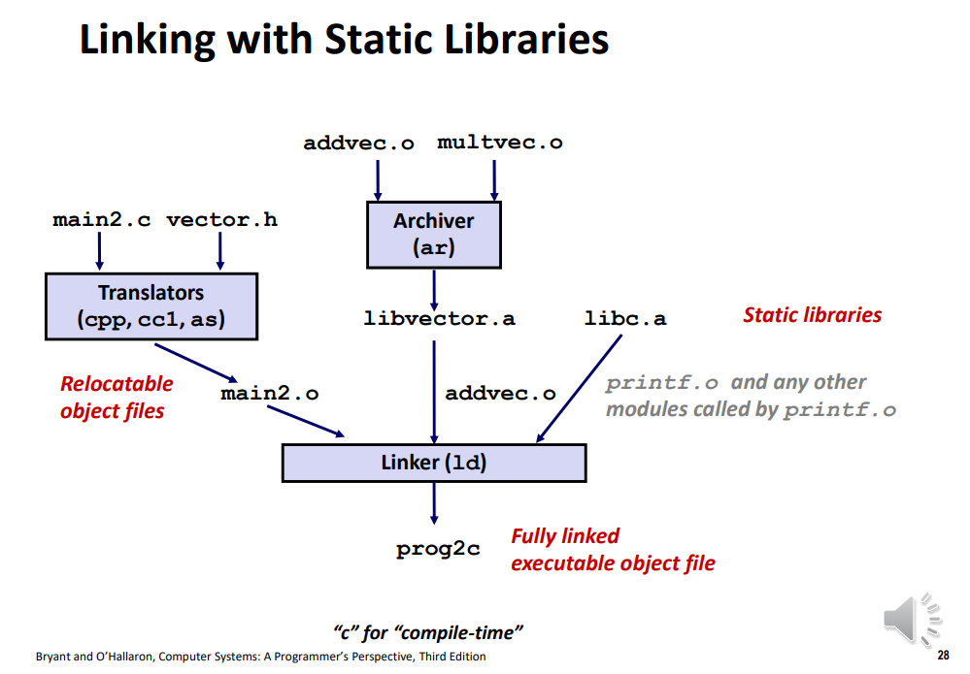
Linking - Static

Slide 18
Linking
Types of linking
2) Dynamic linking:
References are resolved dynamically when the program is run because location of the library is not known until run-time
Only the addresses of the code, not the actual code itself, makes it into the final executable (using a jump table, and a dynamic loader that fills the jump table)
Upon program startup, the dynamic load library is invoked to fill in the jump table with the addresses of each function in the shared library
Can occur at load-time or run-time
Uses .so files
Different programs can share the same library in memory
Only files that have been changed need to be recompiled
Programs may not run as fast because things are performed dynamically
Programs can have variable load-time as some shared libraries are already present in memory
Not as portable if shared libraries don’t exist on different machine

Slide 19
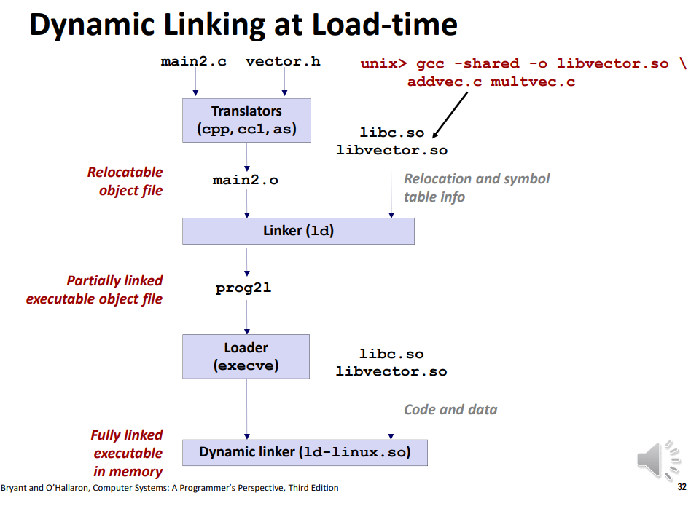
Linking – Dynamic

Slide 20
Virtual Memory
See other slides

Slide 21
Questions before we start worksheet?

Slide 22
Works Cited
Professor Reinman’s slides (CCLE)
LAs – Sidharth Ramanan, Julia Baylon, Sana Shrikant et al.
Credit for compilation: Attiano Purpura-Pontoniere

